Slide 1
Applied Natural Language Processing Project BUAN 6342 Harish Sathiyanarayanan HXS210073

Slide 2
Highlighting the importance and role of preprocessing steps like POS and NER. Explain why these steps are crucial and how they contribute to the summarization process - 5 points
Semantic Understanding: POS tagging helps in identifying the grammatical structure of a sentence by categorizing words into their respective parts of speech (e.g., nouns, verbs, adjectives). NER identifies named entities such as names of people, organizations, and locations. Together, these preprocessing steps provide a deeper semantic understanding of the text, enabling the summarization model to capture the essential information accurately.
Content Selection: POS tagging and NER help in identifying the most important elements within a text. By recognizing nouns and named entities, the summarization model can prioritize including these in the summary, ensuring that essential information is retained. For example, in a news article summary, the names of key individuals or organizations can be crucial for comprehensibility.
Coherence and Flow: Properly tagged and recognized entities contribute to the coherence and flow of the summary. When the model is aware of the parts of speech and named entities, it can construct more grammatically correct and coherent sentences in the summary, resulting in a more readable and contextually relevant output.
Reduction of Redundancy: POS tagging and NER can help reduce redundancy in the summary. By identifying pronouns (e.g., he, she, it) and linking them to the corresponding named entities, the summarization model can avoid repetitive mentions of the same entities in the summary, making it concise and less redundant.
Customization and Adaptation: Depending on the specific use case or domain, POS tagging and NER can be customized or adapted to improve summarization quality. For instance, in a medical text summarization task, recognizing medical terms as named entities can be crucial for generating accurate and informative summaries tailored to that domain.

Slide 3

Summarization Process
NLTK summarization Steps
sPacy summarization Steps
Load the headline.csv
Stop words removal
Lemmatization
Stop words removal
Stemming
Stop words removal
Load the headline.csv
Stop Words Removal
Stop Words Removal
Lemmatization
Lemmatization
Lemmatization
POS Tags
POS tags
POS Tags
Ner Tags
Lemmatization
NER TAGS
Pipeline
TF-IDF & Linear SVC
Lemmatization
Count Vector
TF-IDF & Linear SVC
Text Ranker
Lemmatization
TF-IDF Vector
Text Ranker
Visualization
TF – IDF Vector
Text Ranker
Text Ranker
Visualization

Slide 4
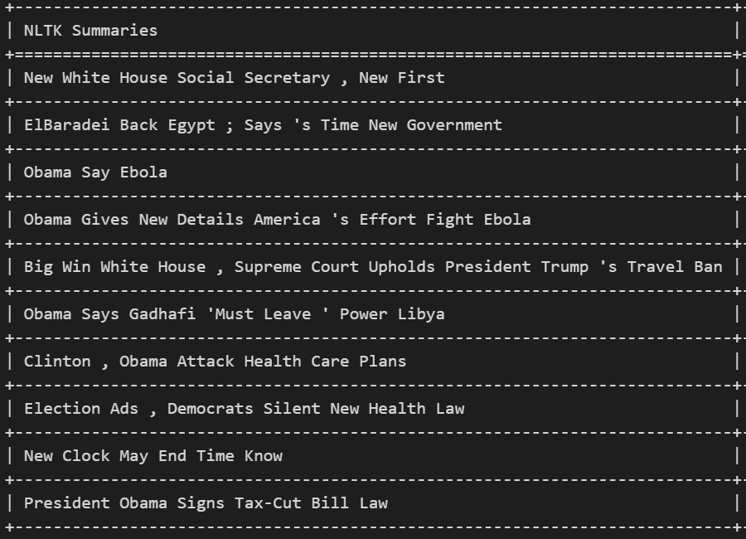
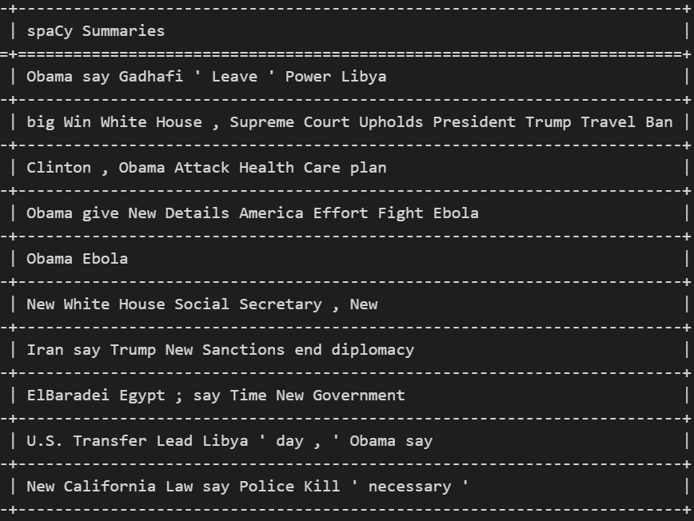
Summarization results ( side by side comparison)
NLTK top 10 headlines news
(screenshot)
sPacy top 10 headlines news
(screenshot)

Slide 5
Conclusion
As a conclusion, which of the following is the best practice for summarization and why?
Both libraries (spaCy & NLTK) are effective for text summarization, with NLTK being slightly more efficient.
Both are effective, but spaCy outperforms NLTK.
Both libraries successfully generate summaries that meet the committee's needs, and the summaries highlight the top 10 most important stories of the day's news. Therefore, depending on the specific project needs, either NLTK or spaCy could be chosen for text summarization.
Answer:
(c) Both libraries successfully generate summaries that meet the committee's needs, and the summaries highlight the top 10 most important stories of the day's news. Therefore, depending on the specific project needs, either NLTK or spaCy could be chosen for text summarization.
Justification:
Flexibility in Library Choice: The option wisely suggests that the choice between NLTK and spaCy should depend on the specific project needs. This is a practical approach because the selection of a text summarization library can indeed vary based on factors such as the nature of the text, available resources, and specific requirements of the project. And, from the output we can see that both NLTK and Spacy can do the assigned jobs with almost good outputs and both has its pros and cons so we can choose either of the both depending upon the project needs.

